Slide 1
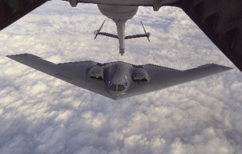
B-2 Spirit
3
Multi-Role Bomber - Air
ATK: Strike (Ground)
REQ: (ATK) Refueler
TRAITS: Stealth
The B-2 Spirit is a multi-role bomber capable of delivering both conventional and nuclear munitions. It provides the penetrating flexibility and effectiveness inherent in manned bombers. Its low-observable (LO) characteristics give it the unique ability to penetrate an enemy's most sophisticated defenses and threaten high valued and heavily defended targets. The revolutionary blending of LO technologies with high aerodynamic efficiency and large payload gives the B-2 freedom of action at high altitudes, thus increasing its range and a better field of view for the aircraft's sensors. Its unrefueled range is approximately 6,000 nautical miles (9,600 km).
6/1
Notes:
http://www.af.mil/About-Us/Fact-Sheets/Display/Article/104482/b-2-spirit/
https://media.defense.gov/2003/Feb/10/2000030307/-1/-1/0/021105-O-9999G-009.JPG

Slide 2
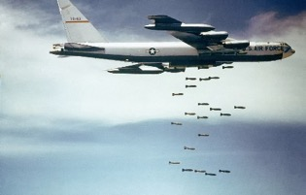
B-52 Stratofortress
2
Multi-Role Bomber - Air
ATK: Strike (Ground)
Close Air Support (Ground Units)
Anti-ship (Naval Units)
REQ: (ATK) Refueler
For more than 40 years, B-52 Stratofortresses have been the backbone of the manned strategic bomber force for the United States. The B-52 is capable of dropping or launching the widest array of weapons in the U.S. inventory. This includes gravity bombs, cluster bombs, precision guided missiles and joint direct attack munitions.The use of aerial refueling gives the B-52 a range limited only by crew endurance. It has an unrefueled combat range in excess of 8,800 miles (14,080 kilometers).
6/1
Notes:
https://commons.wikimedia.org/wiki/File:Boeing_B-52_dropping_bombs.jpg
http://www.af.mil/About-Us/Fact-Sheets/Display/Article/104465/b-52-stratofortress/

Slide 3
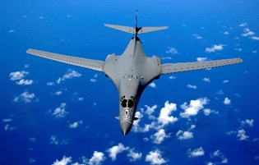
B-1B Lancer
2
Conventional Bomber – Air
ATK: Strike (Ground)
REQ: (ATK) Refueler or Forward Operating Base
Carrying the largest conventional payload of both guided and unguided weapons in the Air Force inventory, the B-1B is the backbone of America's long-range bomber force. It can rapidly deliver massive quantities of precision and non-precision weapons against any adversary, anywhere in the world, at any time. It’s speed and superior handling characteristics allow it to seamlessly integrate in mixed force packages. These capabilities, when combined with its substantial payload, excellent radar targeting system, long loiter time and survivability, make the B-1B a key element of any joint/composite strike force.
6/2
Notes:
https://en.wikipedia.org/wiki/Rockwell_B-1_Lancer#/media/File:B-1B_over_the_pacific_ocean.jpg
http://www.af.mil/About-Us/Fact-Sheets/Display/Article/104500/b-1b-lancer/

Slide 4
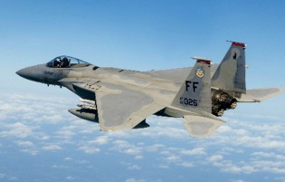
F-15E Strike Eagle
2
Multi-Role - Air
ATK: Offensive Counter Air (Air)
Strike (Ground)
DEF: Defensive Counter Air (Air)
Strike (Ground)
F-15E is a two-seat, dual-role, totally integrated fighter for all-weather, air-to-air and deep interdiction missions. Superior maneuverability and acceleration are achieved through high engine thrust-to-weight ratio and low wing loading.
2/1
Notes:
https://en.wikipedia.org/wiki/McDonnell_Douglas_F-15_Eagle#/media/File:F-15,_71st_Fighter_Squadron,_in_flight.JPG
http://www.af.mil/About-Us/Fact-Sheets/Display/Article/104501/f-15-eagle/

Slide 5
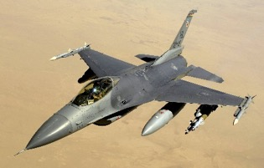
F-16 Fighting Falcon
1
Multi-Role - Air
ATK: Offensive Counter Air (Air)
Strike (Ground)
DEF: Defensive Counter Air (Air)
Strike (Ground)
The F-16's can locate targets in all weather conditions and detect low flying aircraft in radar ground clutter. In an air-to-surface role, the F-16 can fly more than 500 miles (860 kilometers), deliver its weapons with superior accuracy, defend itself against enemy aircraft, and return to its starting point. An all-weather capability allows it to accurately deliver ordnance during non-visual bombing conditions.
1/1
Notes:
https://en.wikipedia.org/wiki/General_Dynamics_F-16_Fighting_Falcon
http://www.af.mil/About-Us/Fact-Sheets/Display/Article/104505/f-16-fighting-falcon/

Slide 6
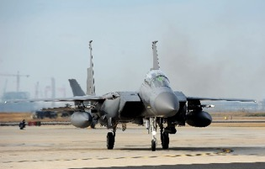
Drop Tank
0
Equipment
TRAITS: Attach to F-16 or F-15 to grant ability to strike two targets (does not apply for OCA or DCA) OR F-22 to fulfill refueler requirement. Discard after use.
In aviation, a drop tank (external tank, wing tank, or belly tank) is used to describe auxiliary fuel tanks externally carried by aircraft. A drop tank is expendable and often jettisonable. (https://en.wikipedia.org/wiki/Drop_tank)
-/-
Notes:
http://www.af.mil/News/Photos/igphoto/2000953878/
https://en.wikipedia.org/wiki/Drop_tank

Slide 7
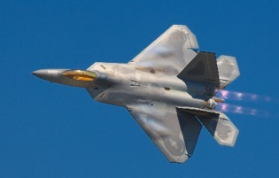
F-22 Raptor
2
Air Superiority – Air
ATK: Offensive Counter Air (Air)
DEF: Defensive Counter Air (Air)
REQ: (ATK) Refueler or Forward Operating Base
TRAITS: Stealth
The combination of stealth, integrated avionics and supercruise drastically shrinks surface-to-air missile engagement envelopes and minimizes enemy capabilities to track and engage the F-22. Advances in low-observable technologies provide significantly improved survivability and lethality against air-to-air and surface-to-air threats. The F-22 brings stealth into the day, enabling it not only to protect itself but other assets.
2/2
Notes:
https://en.wikipedia.org/wiki/Lockheed_Martin_F-22_Raptor#/media/File:Lockheed_Martin_F-22A_Raptor_JSOH.jpg
http://www.af.mil/About-Us/Fact-Sheets/Display/Article/104506/f-22-raptor/

Slide 8
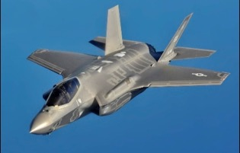
F-35A Joint Strike Fighter
3
Multi-Role - Air
ATK: Offensive Counter Air (Air)
Strike (Ground)
DEF: Defensive Counter Air (Air)
Strike (Ground)
REQ: (ATK) Refueler or Forward Op Base
TRAITS: Stealth, Tactical Data Links grant other units with ATK or DEF a +1 bonus
F-35A combines stealth, sensor fusion, and unprecedented situational awareness and is designed to provide the pilot with unsurpassed situational awareness, positive target identification and precision strike in all weather conditions.
1/1
Notes:
https://en.wikipedia.org/wiki/Lockheed_Martin_F-35_Lightning_II
http://www.af.mil/About-Us/Fact-Sheets/Display/Article/478441/f-35a-lightning-ii-conventional-takeoff-and-landing-variant/

Slide 9
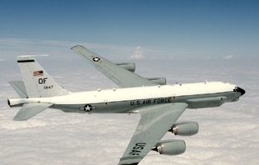
RC-135V/W Rivet Joint
1
Support (ISR) - Air
REQ: Refueler
TRAITS: Reveal deployed enemy ground units and subsequently deployed enemy ground units
The RC-135V/W Rivet Joint reconnaissance aircraft supports theater and national level consumers with near real time on-scene intelligence collection, analysis and dissemination capabilities. Its on-board sensor suite allows the mission crew to detect, identify and geolocate signals throughout the electromagnetic spectrum. The mission crew can then forward gathered information in a variety of formats to a wide range of consumers via Rivet Joint's extensive communications suite.
0/1
Notes:
https://en.wikipedia.org/wiki/Boeing_RC-135
http://www.af.mil/About-Us/Fact-Sheets/Display/Article/104608/rc-135vw-rivet-joint/

Slide 10
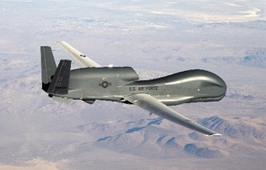
RQ-4 Global Hawk
0
Support (ISR) - Air
REQ: Air Superiority
TRAITS: Reveal deployed enemy ground units and subsequently deployed enemy ground units
The RQ-4 Global Hawk is a high-altitude, long-endurance, remotely piloted aircraft with an integrated sensor suite that provides global all-weather, day or night intelligence, surveillance and reconnaissance (ISR) capability. Global Hawk's mission is to provide a broad spectrum of ISR collection capability to support joint combatant forces in worldwide peacetime, contingency and wartime operations. The Global Hawk provides persistent near-real-time coverage using imagery intelligence (IMINT), signals intelligence (SIGINT) and moving target indicator (MTI) sensors.
0/1
Notes:
https://en.wikipedia.org/wiki/Northrop_Grumman_RQ-4_Global_Hawk#/media/File:Global_Hawk_1.jpg

Slide 11
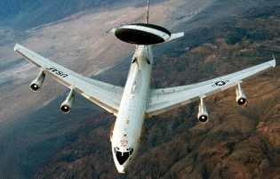
E-3 Sentry (AWACS)
3
Support (ISR) - Air
REQ: Refueler or Forward Operating Base
TRAITS: Reveals stealth aircraft
The E-3 Sentry is an airborne warning and control system, or AWACS, aircraft with an integrated command and control battle management (C2BM) surveillance, target detection, and tracking platform. It provides an accurate, real-time picture of the battlespace to the Joint Air Operations Center. AWACS provides situational awareness of friendly, neutral and hostile activity, command and control of an area of responsibility, battle management of theater forces, all-altitude and all-weather surveillance of the battle space, and early warning of enemy actions during joint, allied, and coalition operations. As an air defense system, E-3s can detect, identify and track airborne enemy forces far from the boundaries of the United States or NATO countries. It can direct fighter-interceptor aircraft to these enemy targets.
0/1
Notes:
https://en.wikipedia.org/wiki/Boeing_E-3_Sentry#/media/File:E-3_Sentry_exercise_Green_Flag_2012_(Cropped).jpg
http://www.af.mil/About-Us/Fact-Sheets/Display/Article/104504/e-3-sentry-awacs/

Slide 12
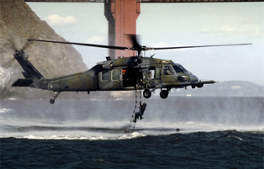
HH-60G Pave Hawk
2
Support (CSAR) - Air
TRAITS: Rescue pilots/crew -- downed aircraft return to hand instead of discard. Return this card to hand (if over hand limit, discard a card)
The primary mission of the HH-60G Pave Hawk helicopter is to conduct day or night personnel recovery operations into hostile environments to recover isolated personnel during war. The HH-60G is also tasked to perform military operations other than war, including civil search and rescue, medical evacuation, disaster response, and humanitarian assistance. HH-60G rescue equipment includes a hoist capable of lifting a 600-pound load (270 kilograms) from a hover height of 200 feet (60.7 meters), and a personnel locating system that is compatible with the PRC-112 survival radio and provides range and bearing information to a survivor's location.
0/1
Notes:
http://www.hurlburt.af.mil/About-Us/Fact-Sheets/Fact-Sheets/Article/204557/mh-53-pave-low/

Slide 13
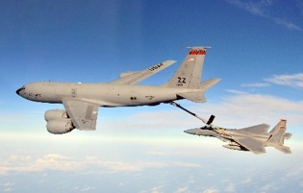
KC-135 Stratotanker
1
Support (Refueler) - Air
Traits: Provides aerial refueling to support other assets
The KC-135 Stratotanker provides the core aerial refueling capability for the United States Air Force and has excelled in this role for more than 50 years. This unique asset enhances the Air Force's capability to accomplish its primary mission of global reach. It also provides aerial refueling support to Air Force, Navy, Marine Corps and allied nation aircraft. Some aircraft have been configured with the multipoint refueling system, which consists of special pods mounted on the wingtips. These KC-135s are capable of refueling two receiver aircraft at the same time.
0/1
Notes:
https://en.wikipedia.org/wiki/Boeing_KC-135_Stratotanker#/media/File:F-15C_Eagle_from_the_67th_Fighter_Squadron_at_Kadena_AB_is_refueled_by_a_KC-135R_Stratotanker_from_the_909th_Air_Refueling_Squadron_.jpg
http://www.af.mil/About-Us/Fact-Sheets/Display/Article/104524/kc-135-stratotanker/

Slide 14
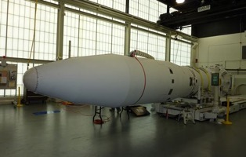
2
Operationally Responsive Space
Support (ISR) - Space
TRAITS: Variable payloads—choose one:
Comm (Ground units gain +1 DEF); ISR (Reveal deployed enemy ground units and subsequently deployed enemy ground units); Weather (Air units with strike gain+1 ATK)
Operationally Responsive Space, located at Kirtland AFB, is a joint initiative of several agencies within the U.S. Department of Defense. The mission of ORS is to plan and prepare for the rapid development of highly responsive space capabilities that enable delivery of timely warfighting effects and, when directed, develop and support deployment and operations of these capabilities to enhance and assure support the needs of Joint Force commanders and other users for on-demand space support, augmentation, and reconstitution
0/1
Notes:
http://www.kirtland.af.mil/News/Article-Display/Article/389751/launch-date-set-for-operationally-responsive-spaces-inaugural-satellite/
http://www.kirtland.af.mil/Portals/52/documents/ORS-3-Payloads.pdf?ver=2016-11-22-133147-897

Slide 15
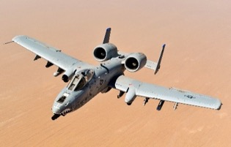
A-10 Thunderbolt II
0
Close Air Support – Air
ATK: Close Air Support (Ground Units)
DEF: Close Air Support (Ground Units)
The A-10 Thunderbolt II has excellent maneuverability at low air speeds and altitude, and is a highly accurate and survivable weapons-delivery platform. The aircraft can loiter near battle areas for extended periods of time and operate in low ceiling and visibility conditions. The wide combat radius and short takeoff and landing capability permit operations in and out of locations near front lines. It can be serviced and operated from austere bases with limited facilities near battle areas. Many of the aircraft's parts are interchangeable left and right, including the engines, main landing gear and vertical stabilizers. Avionics equipment includes multi-band communications; Global Positioning System and inertial navigations systems; infrared and electronic countermeasures against air-to-air and air-to-surface threats.
2/2
Notes:
https://en.Wikipedia.org/wiki/Fairchild_Republic_A-10_Thunderbolt_II#/media/File:USAF_A-10_Thunderbolt_II_after_taking_on_fuel_over_Afghanistan.jpg
http://www.af.mil/About-Us/Fact-Sheets/Display/Article/104490/a-10-thunderbolt-ii/

Slide 16
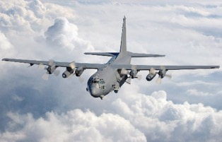
2
AC-130U “Spooky” Gunship
Special Forces - Air
ATK: Close Air Support (Ground units)
DEF: Force Protection (Ground units)
Traits: Ground units gain +1 ATK
The AC-130U “Spooky” gunships’ primary missions are close air support, air interdiction and armed reconnaissance. Close air support missions include troops in contact, convoy escort and point air defense. Air interdiction missions are conducted against preplanned targets or targets of opportunity and include strike coordination, reconnaissance, and armed overwatch mission sets.
1/0
Notes:
https://en.wikipedia.org/wiki/Lockheed_AC-130#/media/File:AC-130U_gunship_from_the_4th_Special_Operations_Squadron.jpg
http://www.af.mil/About-Us/Fact-Sheets/Display/Article/104486/ac-130u/

Slide 17
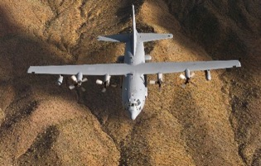
2
EC-130H Compass Call
Support (SEAD) - Air
TRAITS: Enemy cannot employ non-revealed units for defensive counter-air
The EC-130H Compass Call is an airborne tactical weapon system that disrupts enemy command and control communications and limits adversary coordination essential for enemy force management. The Compass Call system employs offensive counter-information and electronic attack (or EA) capabilities in support of U.S. and Coalition tactical air, surface, and special operations forces. The EC-130H, EA-6B or EA-18G, and F-16CJ, form the Suppression of Enemy Air Defense (SEAD) triad. The Compass Call integrates into tactical air operations at any level. The versatile and flexible nature of the aircraft and its crew enable the power of electronic combat to be brought to bear in virtually any combat situation.
-/-
Notes:
http://www.af.mil/About-Us/Fact-Sheets/Display/article/104550/ec-130h-compass-call/

Slide 18
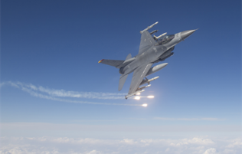
F-16CJ Wild Weasel
1
Support (SEAD) - Air
TRAITS: Negates all ground-based anti-air defenses against equipped attacking air asset (attach to deployed aircraft like “equipment”—discard after sortie)
The goal of SEAD is to establish an environment that allows friendly aircraft to attack in the safest, most effective manner. SEAD entails neutralizing, destroying, or temporarily degrading enemy integrated air defense command, control, communications, and radar systems that are directing surface-to-air missiles and anti-air artillery against friendly aircraft. Lethal SEAD physically destroys or incapacitates crucial parts of the air defense system such as radar antennae and communications links. Nonlethal SEAD electronically jams (or interferes with) these systems to temporarily degrade their effectiveness.
-/-
Notes:
http://www.af.mil/News/Article-Display/Article/109274/misawa-fighter-jets-break-new-training-barriers/
http://www.gao.gov/assets/220/218543.pdf

Slide 19
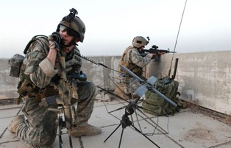
1
Tactical Air Control Party (TACP)
Support (ISR) - Ground
REQ: Embedded with ground unit (attach to ground unit – played like equipment)
Traits: Unit providing Close Air Support provides CAS on two targets
In the joint forces war that is fought today, the tactical air control party is the glue that brings air and ground power together. TACP Airmen serve as liaisons between Army ground commanders and pilots to coordinate close air support for ground forces with which they're embedded. TACPs advise ground commanders on employing airpower and control aircraft to put bombs on target.
-/-
Notes:
http://www.af.mil/News/Article-Display/Article/502882/tacp-m-ties-it-all-together/
http://www.af.mil/News/Article-Display/Article/116150/tacp-joint-effort-puts-bombs-on-target/

Slide 20
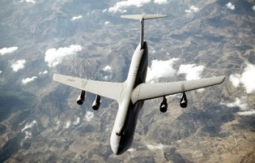
C-5 Galaxy
3
Support (Rapid Global Mobility) - Air
REQ: Air Superiority
TRAITS: Draw additional card per turn OR deploy any Army ground units at 1 cost
The C-5 Galaxy is one of the largest aircraft in the world and the largest airlifter in the Air Force inventory. The aircraft can carry a fully equipped combat-ready military unit to any point in the world on short notice and then provide the supplies required to help sustain the fighting force. It has the ability to carry 36 standard pallets and 81 troops simultaneously. The Galaxy is also capable of carrying any of the Army's air-transportable combat equipment, including such bulky items as the 74-ton mobile scissors bridge, outsize and oversize cargo over intercontinental ranges, and can take off or land in relatively short distances.
0/1
Notes:
https://en.wikipedia.org/wiki/Lockheed_C-5_Galaxy
http://www.af.mil/About-Us/Fact-Sheets/Display/Article/104492/c-5-abc-galaxy-c-5m-super-galaxy/

Slide 21

Ransomware
1
Exploit - Cyber
ATK: (2 or higher) They paid--discard ½ of the enemy’s hand (without looking)
REQ: Any Gained Access Card
TRAITS: Single-use
In a ransomware attack, victims click on an attachment containing malicious ransomware code or an URL directed to a website that infects their computer. Once infected, the malware begins encrypting files and folders on local drives, any attached drives, backup drives, and potentially other computers on the same network that the victim computer is attached to. Users are generally not aware they have been infected until they can no longer access their data or until they begin to see demands for a ransom payment in exchange for a decryption key. (https://www.fbi.gov/news/stories/incidents-of-ransomware-on-the-rise)
-/-
Notes:
https://pixabay.com/en/laptop-keyboard-cyber-attack-2450155/

Slide 22

White Hats
1
Cognitive - Cyber
DEF: Look through your draw or discard pile and put a cyber defense or mitigation card into your hand, reshuffle draw pile. The card can be deployed immediately, with payment.
The term "white hat" in Internet slang refers to an ethical computer hacker, or a computer security expert, who specializes in penetration testing and in other testing methodologies to ensure the security of an organization's information systems. (https://en.wikipedia.org/wiki/White_hat_%28computer_security%29)
-/-
Notes:
https://www.pexels.com/photo/light-black-and-white-man-person-67603/

Slide 23

0
Knowledge Management
Cognitive - Cyber
DEF: Return a cyber card from your discard pile to your hand
TRAITS: Charge, Single-use
"Knowledge management is a discipline that promotes an integrated approach to identifying, capturing, evaluating, retrieving, and sharing all of an enterprise's information assets. These assets may include databases, documents, policies, procedures, and previously un-captured expertise and experience in individual workers.“ (http://www.kmworld.com/Articles/Editorial/What-Is-.../What-is-KM-Knowledge-Management-Explained-82405.aspx)
-/-
Notes:
https://www.pexels.com/photo/white-concrete-tall-building-with-books-159870/

Slide 24

1
Data Analytics
Cognitive - Cyber
DEF: (3 or higher) Look at next 6 cards in either your draw pile OR opponent’s draw pile
TRAITS: Charge; Single-use
There are four types of data analytics: Descriptive (What), Diagnostic (Why), Predictive (What’s likely), and Prescriptive (What needs to be done). (http://www.kdnuggets.com/2017/07/4-types-data-analytics.html)
-/-
Notes:
https://www.pexels.com/photo/eye-eyelash-macro-eyelid-508949/

Slide 25

Automated Task Mgmt
2
Cognitive - Cyber
DEF: Reduce cost of deploying cyber reconnaissance, defense, or mitigation cards by 1. If that card costs 0, draw another card (but the drawn card cannot be played this turn).
Automating task management frees up security teams and network administrators from routine tasks so they can focus on higher level complexity problems such as strategic planning and incident response.
-/-
Notes:
https://pixabay.com/en/robot-artificial-intelligence-woman-507811/

Slide 26

1
Security Training
Cognitive - Cyber
DEF: -1 decrease to enemy cyber Reconnaissance ATK attempt (-2 for Insider Threat)
Security training provides an overview of operational security (OPSEC). It increases awareness of what information an adversary may view as valuable and provide tools to recognize potential weaknesses in your daily operations and techniques so you can do something about those weaknesses. OPSEC crosses all fields and environments and even extends to your private life. (https://ics-cert.us-cert.gov/Training-Available-Through-ICS-CERT)
-/-
Notes:
https://www.pexels.com/photo/strong-lock-locked-padlock-39624/

Slide 27

1
Encryption
Defense - Cyber
DEF: Remove Sniffing and Spoofing ATK in play and -3 decrease to future attempts
Encryption is a way to send a message in code. The only person who can decode the message is the person with the correct key; to anyone else, the message looks like a random series of letters, numbers, and characters. Encryption is especially important if you are trying to send sensitive information that other people should not be able to access. Because email messages are sent over the internet and might be intercepted by an attacker, it is important to add an additional layer of security to sensitive information.
(https://www.us-cert.gov/ncas/tips/ST04-019)
-/-
Notes:
https://www.pexels.com/photo/strong-lock-locked-padlock-39624/

Slide 28

Access Control List
1
Defense - Cyber
DEF: -3 decrease to enemy Gaining Access ATK attempt (except Insider Threat which only gets a -1 penalty)
On this turn, enemy must re-roll all in play cyber ATK cards to keep them in place, accounting for all modifiers currently in play, discarding any that fail (ignore REQ)
An access control list (ACL), with respect to a computer file system, is a list of permissions attached to an object. An ACL specifies which users or system processes are granted access to objects, as well as what operations are allowed on given objects. Each entry in a typical ACL specifies a subject and an operation.
-/-
Notes:
https://pixabay.com/en/security-safety-concept-eyes-1163108/

Slide 29

0
Firewalls
Defense - Cyber
DEF: Remove existing Worm ATK and -3 decrease to enemy Worm ATK attempt
Firewalls provide protection against outside attackers by shielding your computer or network from malicious or unnecessary network traffic and preventing malicious software from accessing the network. Firewalls can be configured to block data from certain locations or applications while allowing relevant and necessary data through. Firewalls do not guarantee that your computer will not be attacked. Firewalls primarily help protect against malicious traffic, not against malicious programs (malware), and may not protect you if you accidentally install malware on your computer.
(https://www.us-cert.gov/ncas/tips/ST04-004)
-/-
Notes:
https://www.pexels.com/photo/fire-orange-emergency-burning-1749/

Slide 30
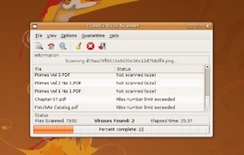
0
Anti-Virus
Defense - Cyber
DEF: Remove existing Trojan, Worm and Rootkit ATK and -1 decrease to future enemy Trojan, Worm, and Rootkit ATK attempts
Anti-virus software scans files or your computer’s memory for certain patterns that may indicate the presence of malicious software (i.e., malware). Anti-virus software (sometimes more broadly referred to as anti-malware software) looks for patterns based on the signatures or definitions of known malware. Anti-virus vendors find new and updated malware daily, so it is important that you have the latest updates installed on your computer. (https://www.us-cert.gov/ncas/tips/ST04-005)
-/-
Notes:
https://en.wikipedia.org/wiki/Antivirus_software#/media/File:ClamTK3.08.jpg

Slide 31

1
Redundant Servers
Mitigation - Cyber
DEF: Neutralize a single DDoS attack
TRAITS: Data Analytics cost reduced by 1
Server redundancy refers to the amount and intensity of backup, failover or redundant servers in a computing environment. It defines the ability of a computing infrastructure to provide additional servers that may be deployed on runtime for backup, load balancing or temporarily halting a primary server for maintenance purposes. It is implemented in an enterprise IT infrastructure where server availability is of paramount importance. To enable server redundancy, a server replica is created with the same computing power, storage, applications and other operational parameters. (https://www.techopedia.com/definition/14718/server-redundancy)
-/-
Notes:
https://www.pexels.com/photo/black-and-grey-device-159282/

Slide 32
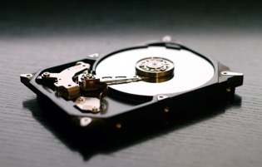
1
Backups
Mitigation - Cyber
DEF: -2 decrease to enemy Ransomware ATK attempt
All computer users should back up the critical data they have on their desktops, laptops, servers, and even mobile devices to protect it from loss or corruption. Saving just one backup file may not be enough to safeguard your information. To increase your chances of recovering lost or corrupted data, follow the 3-2-1 rule:
3 – Keep 3 copies: 1 primary and 2 backups.
2 – Keep the files on 2 different media types
1 – Store 1 copy offsite
(https://www.us-cert.gov/sites/default/files/publications/data_backup_options.pdf)
-/-
Notes:
https://www.pexels.com/photo/strong-lock-locked-padlock-39624/

Slide 33

1
Incident Response Team
Mitigation - Cyber
DEF: Recover ½ of cards discarded as a result of a cyber ATK requiring discard
A computer security incident response team (CSIRT) is a concrete organizational entity that is assigned the responsibility for coordinating and supporting the response to a computer security event or incident. Incident management includes detecting and responding to computer security incidents as well as protecting critical data, assets, and systems to prevent incidents from happening. Actions taken to prevent or mitigate ongoing and potential computer security events and incidents can involve tasks performed by a wide range of participants across the enterprise. (https://www.us-cert.gov/bsi/articles/best-practices/incident-management/defining-computer-security-incident-response-teams)
-/-
Notes:
https://www.pexels.com/photo/blur-computer-connection-electronics-442150/

Slide 34

0
Scanning & Fingerprinting
Reconnaissance - Cyber
ATK: +1 to Worm ATK attempt
DEF: -1 to any Gain Access attempt, except Insider Threat
Nmap ("Network Mapper") is a free and open source utility for network discovery and security auditing. Nmap uses raw IP packets in novel ways to determine what hosts are available on the network, what services (application name and version) those hosts are offering, what operating systems (and OS versions) they are running, what type of packet filters/firewalls are in use, and dozens of other characteristics. (https://nmap.org/)
-/-
Notes:
https://nmap.org/book/man-legal.html (NMap is GNU)

Slide 35

0
Phishing
Reconnaissance - Cyber
ATK: (3 or higher) +1 to Gaining Access cards’ ATK attempt
Phishing attacks typically use email to con victims into divulging sensitive information. It can be easily automated and requires minimal human involvement. (Starvoulakis and Stump, Handbook of Information and Communication Security, 2010)
-/-
Notes:
https://www.pexels.com/photo/business-communication-computer-connection-261706/

Slide 36

0
Sniffing (Packet Analysis)
Reconnaissance - Cyber
ATK: +2 to Spoofing ATK attempt
Packet sniffing, or packet analysis, is the process of capturing any data passed over the local network and looking for any information that may be useful. Most of the Internet runs in plain text, which means that most of the information you look at is viewable by someone with a packet sniffer. This information ranges from the benign to the sensitive. Tools like Wireshark, Ettercap or NetworkMiner give anybody the ability to sniff network traffic with a little practice or training(http://www.linuxjournal.com/content/packet-sniffing-basics)
-/-
Notes:
https://www.pexels.com/photo/photo-of-guy-fawkes-mask-with-red-flower-on-top-on-hand-38275/

Slide 37

Dumpster Dive
1
Reconnaissance - Cyber
ATK: (2 or higher) +1 to Gaining Access cards’ ATK attempt
Traits: Removes enemy Access Control List (if revealed at time of play)
Dumpster diving is looking for treasure in someone else’s trash. The nature of the items and/or information found can be anything from medical records, resumes, personal photos and emails, bank statements, account details or information about software, tech support logs and so much more. Of course all of this information can be used to leverage an attack against a victim.
(https://www.social-engineer.org/framework/information-gathering/dumpster-diving/)
-/-
Notes:
https://www.pexels.com/photo/container-garbage-trash-waste-85081/

Slide 38

Social Engineering
1
Reconnaissance - Cyber
ATK: (2 or higher) +1 to Phishing ATK attempt, +1 to Gaining Access cards’ ATK attempt, +2 to Blackmail ATK attempt
Social engineering is the art of manipulating people so they give up confidential information, such as passwords or bank information, or access your computer to secretly install malicious software–that will give them access to your passwords and bank information as well as giving them control over your computer. Criminals use social engineering tactics because it is usually easier to exploit your natural inclination to trust than it is to discover ways to hack your software.(https://www.webroot.com/us/en/home/resources/tips/online-shopping-banking/secure-what-is-social-engineering)
-/-
Notes:
https://www.pexels.com/photo/portrait-of-young-woman-eating-fruit-against-white-background-257283/

Slide 39

0
Backdoor Trojan
Gaining Access - Attack
ATK: (3 or higher) grants Gained Access, at the start of the enemy’s turn, look at the top card of the opponents draw deck before they draw
A backdoor Trojan computer virus is a piece of malicious software that usually finds a way into its victim computers without the knowledge or consent of the owners. Once one of these viruses gets to work in a victim computer, it can enable the computer to be accessed and controlled remotely. This puts all data stored on the computer at risk, as well as endangers anyone who may enter personal information into the computer. (https://www.techwalla.com/articles/how-to-remove-a-backdoor-trojan-computer-virus)
-/-
Notes:
https://www.pexels.com/photo/business-computer-connection-contemporary-450035/

Slide 40

Insider Threat
2
Gaining Access - Cyber
ATK: (3 or higher) grants Exploit cards’ +2 ATK attempt, reveal an enemy facedown deployed card per turn
REQ: Successfully deploy this card for free (without attempt roll) if Blackmail successful
Insiders pose a substantial threat because they have the knowledge and access to proprietary systems that allow them to bypass security measures through legitimate means. The nature of insider threats is different from other cybersecurity challenges; these threats require a different strategy for preventing and addressing them. (http://www.cert.org/insider-threat/)
-/-
Notes:
https://www.pexels.com/photo/business-girl-manager-pen-261622/

Slide 41


2
0-Day Exploit
DAY
0
Gaining Access - Cyber
ATK: (2 or higher) grants Gained Access, play any cyber gaining access or exploit card in your hand or discard for free
REQ: Phishing or Scanning & Fingerprinting
TRAITS: Charge, Single-use, Negates cyber defense penalties
A zero day vulnerability refers to a hole in software that is unknown to the developers. This security hole is then exploited by hackers before the vendor becomes aware and fixes it. Uses of zero days can include infiltrating malware, spyware or allowing unwanted access to user information. The term “zero day” refers to the unknown nature of the hole to those outside of the hackers (www.pctools.com/security-news/zero-day-vulnerability/)
-/-
Notes:
https://pixabay.com/en/hacker-cyber-crime-security-1952027/
https://pixabay.com/p-2300772/?no_redirect
https://upload.wikimedia.org/wikipedia/commons/thumb/3/39/Blank_Calendar_page_icon.svg/847px-Blank_Calendar_page_icon.svg.png

Slide 42

1
Rootkit
Gaining Access - Cyber
ATK: (3 or higher) grants Gained Access, enemy cyber defenses lose -1 DEF effect
Rootkits have two primary functions: remote command/control (back door) and software eavesdropping. Rootkits allow someone, legitimate or otherwise, to administratively control a computer. This means executing files, accessing logs, monitoring user activity, and even changing the computer's configuration. Rootkits can't propagate by themselves rootkits are just one component of a blended threat. Blended threats typically consist of three snippets of code: a dropper, loader, and rootkit. Blended threat malware gets its foot in the door through social engineering, exploiting known vulnerabilities, or even brute force. (http://www.techrepublic.com/blog/10-things/10-plus-things-you-should-know-about-rootkits/)
-/-
Notes:
https://www.pexels.com/photo/green-water-fountain-225769/

Slide 43
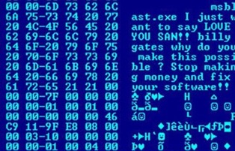
0
Worm
Gaining Access - Cyber
ATK: (3 or higher) grants Gained Access, enemy draws one additional card per turn but without looking must discard one from the draw
REQ: Scanning & Fingerprinting
A computer worm is a standalone malware computer program that replicates itself in order to spread to other computers. Often, it uses a computer network to spread itself, relying on security failures on the target computer to access it. Unlike viruses, they don’t need a cybercriminal’s guidance, nor do they need to latch onto another computer program. (http://www.pctools.com/security-news/what-is-a-computer-worm/)
-/-
Notes:
https://commons.wikimedia.org/wiki/File:Virus_Blaster.jpg

Slide 44

1
Spoofing (Man-in-the-Middle)
Exploit - Cyber
ATK: (5 or higher) Confuse enemy C2--discard a deployed or revealed enemy card
REQ: Sniffing or Scanning & Fingerprinting
A man-in-the-middle (MITM) attack occurs when someone between you and the person with whom you are communicating is actively monitoring, capturing, and controlling your communication transparently. The attacker can re-route a data exchange. MITM attacks are like someone assuming your identity. The person on the other end might believe it is you because the attacker might be actively replying as you to keep the exchange going and gain more information. (https://technet.microsoft.com/en-us/library/cc959354.aspx)
-/-
Notes:
Note: attack is effective each turn until the card is removed or sniffing or scanning & fingerprinting is lost.
https://www.pexels.com/photo/close-up-of-human-hand-327533/

Slide 45
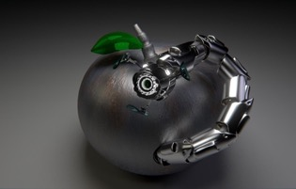
2
Advanced Persistent Threat
Exploit - Cyber
ATK: (4 or higher) Randomly discard one card from their supply draws during the enemy turn on their turn
REQ: Gained Access
An advanced persistent threat (APT) uses multiple phases to break into a network, avoid detection, and harvest valuable information over the long term. The "advanced" process signifies sophisticated techniques using malware to exploit vulnerabilities in systems. The "persistent" process suggests that an external command and control system is continuously monitoring and extracting data from a specific target. The "threat" process indicates human involvement in orchestrating the attack. (https://www.academia.edu/6309905/Advanced_Persistent_Threat_-_APT)
-/-
Notes:
https://pixabay.com/en/robot-worm-apple-trojan-707219/

Slide 46

Blackmail/Extortion
1
Exploit - Cyber
ATK: (Hard 6, no modifiers) Deploying Insider Threat costs 0 with no other REQ
REQ: Dumpster Diving or Social Engineering
Blackmail is an act, often criminal, involving unjustified threats to make a gain—most commonly money or property—or cause loss to another unless a demand is met. It is coercion involving threats to reveal substantially true or false information about a person to the public, a family member, or associates, or threats of physical harm or criminal prosecution. Blackmail may also be considered a form of extortion. Although the two are generally synonymous, extortion is the taking of personal property by threat of future harm. (https://en.wikipedia.org/wiki/Blackmail)
-/-
Notes:
https://www.pexels.com/photo/black-and-white-hands-mask-bussinesman-64699/

Slide 47
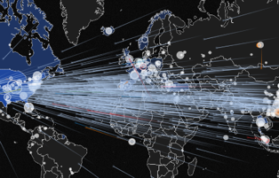
0
Distributed Denial of Service
Attack - Cyber
ATK: (1 or higher) Enemy cannot deploy cards next turn
REQ: Redundant Servers or Trojan Backdoor or Rootkit
TRAITS: Charge; Single-use
In a distributed denial-of-service (DDoS) attack, an attacker may use your computer to attack another computer. By taking advantage of security vulnerabilities or weaknesses, an attacker could take control of your computer and then force your computer to send huge amounts of data to a website or send spam to particular email addresses. The attack is "distributed" because the attacker is using multiple computers, including yours, to launch the denial-of-service attack. (https://www.us-cert.gov/ncas/tips/ST04-015)
-/-
Notes:
https://www.us-cert.gov/ncas/tips/ST04-015

Slide 48
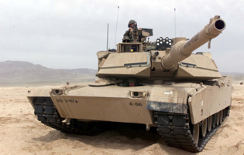
M1A2 Abrams Tank
2
Armored BCT - Ground
ATK: (Ground)
DEF: (Ground)
REQ: (ATK) Forward Operating Base
The ABCT’s role is to close with the enemy using fire and movement to destroy or capture enemy forces, to repel enemy attacks by fire, to engage in close combat, and to counterattack to control land areas. It organizes to concentrate overwhelming combat power. Mobility, protection, and firepower enable it to conduct offensive tasks with great precision and speed. The ABCT conducts offensive tasks to defeat, destroy, or neutralize the enemy and defensive tasks to defeat an enemy attack and develop favorable conditions for offensive actions. During stability, the ABCT’s commitment of time, resources, and forces establish & reinforce diplomatic
and military resolve to achieve a safe, secure environment and a sustainable peace.
3/3
Notes:
https://commons.wikimedia.org/wiki/File:M1a2-2_large.jpg
This image or file is a work of a U.S. Air Force Airman or employee, taken or made as part of that person's official duties. As a work of the U.S. federal government, the image or file is in the public domain in the United States.
https://en.wikipedia.org/wiki/M1_Abrams

Slide 49
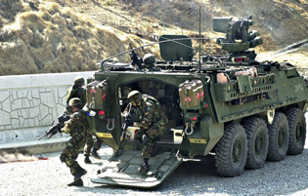
Stryker
1
Stryker BCT - Ground
ATK: (Ground)
DEF: (Ground)
REQ: (ATK) Forward Operating Base
The Stryker BCT is an expeditionary combined arms force organized around mounted infantry. SBCT units operate effectively in most terrain and weather conditions due to their rapid strategic deployment and mobility. Their role is to close with the enemy by means of fire and movement, to destroy or capture enemy forces, or repel enemy attacks by fire, close combat, and counterattack to control land areas, including populations and resources. The SBCT can gain the initiative early, seize and retain key terrain, any locality, or area, the seizure or retention of which affords a marked advantage to either combatant (JP 2-01.3), and conduct massed fire, fire
from a number of weapons directed at a single point or small area (JP 3-02), to stop the enemy
2/2
Notes:
Caption: "US Army's 1-23 Infantry "Alpha Company" Stryker team members deploy from a Stryker Vehicle to provide suppressive fire on the enemy during a simulated convoy attack during a Reception, Staging, Onward movement, and Integration/Foal Eagle exercise (RSO&I/Foal Eagle). RSO&I is a complex multi-phase exercise conducted annually, tailored to train, test, and demonstrate United States and Republic of Korea (ROK) Force projection and deployment capabilities which was recently completed.“ Date20 March 2005Sourcehttp://www.navy.mil/view_image.asp?id=22913AuthorU.S. Navy photo by Journalist 2nd Class John J. Pistone
Text:
http://data.cape.army.mil/web/character-development-project/repository/fm3-96-2015.pdf

Slide 50
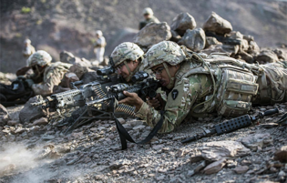
Infantry
0
Infantry BCT - Ground
ATK: (Ground)
DEF: (Ground)
The IBCT is an expeditionary, combined arms formation optimized for dismounted operations in complex terrain. The role of the IBCT is to close with the enemy using fire and movement to destroy or capture enemy forces, or to repel enemy attacks by fire, close combat, and counterattack. Fire and movement is the concept of applying fires from all sources to suppress, neutralize, or destroy the enemy, and the tactical movement of combat forces in relation to the enemy (as components of maneuver applicable at all echelons).
1/1
Notes:
Soldiers fire weapons at staged targets during a live fire exercise, as part of Alligator Dagger in Djibouti, Dec. 17, 2017. The Soldiers are assigned to 3rd Battalion, 144th Infantry Regiment, Task Force Bayonet, attached to the Combined Joint Task Force - Horn of Africa. (U.S. Air Force photo by Staff Sgt. Allyson L. Manners)
https://www.army.mil/photos
https://www.army.mil/e2/c/images/2018/01/19/504097/original.jpg
Text:
http://data.cape.army.mil/web/character-development-project/repository/fm3-96-2015.pdf

Slide 51
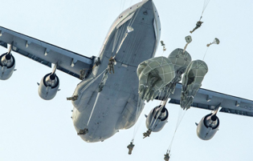
Airborne
1
Infantry BCT – Air/Ground
ATK: (Ground) Treat as Air for 1st use, ground subsequently
DEF: (Ground)
REQ: Air Superiority
TRAITS: Charge; BCT only w/ Airborne
Airborne IBCTs can conduct vertical envelopment by parachute assault. The IBCT’s dismounted capability in complex terrain separates it from other functional brigades and BCTs.
1/1
Notes:
https://www.army.mil/photos
https://www.army.mil/e2/c/images/2018/02/01/505536/original.jpg
Paratroopers assigned to the 4th Infantry Brigade Combat Team (Airborne), 25th Infantry Division, U.S. Army Alaska, jump from an Air Force C-17 Globemaster III with the 517th Airlift Squadron during airborne training over Malemute drop zone, Joint Base Elmendorf-Richardson, Alaska, Jan. 9, 2018. (U.S. Air Force photo by Alejandro Pentildea)
Text:
http://data.cape.army.mil/web/character-development-project/repository/fm3-96-2015.pdf

Slide 52
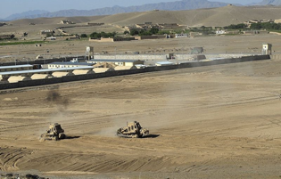
2
Forward Operating Base
Support (Logistics) - Ground
A forward operating base (FOB) is any secured forward military position, commonly a military base, that is used to support tactical operations. An FOB may or may not contain an airfield, hospital, or other facilities. The base may be used for an extended period of time. FOBs are traditionally supported by Main Operating Bases that are required to provide backup support to them. An FOB also improves reaction time to local areas as opposed to having all troops on the main operating base. In its most basic form, a FOB consists of a ring of barbed wire around a position with a fortified entry control point, or ECP. More advanced FOBs include an assembly of earthen dams, concrete barriers, gates, watchtowers, bunkers and other force protection infrastructure.
0/2
Notes:
https://commons.wikimedia.org/wiki/File:Forward_Operating_Base_Logar,_Afghanistan.jpg
http://www.army.mil/-images/2007/06/05/5446/ , exact source
Text from https://en.wikipedia.org/wiki/Forward_operating_base

Slide 53
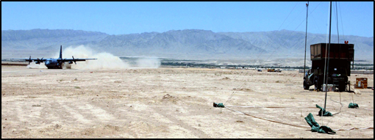
1
FOB Runway
Support (Logistics) - Ground
REQ: Forward Operating Base
TRAITS: Adds 1 HP to a FOB and enables FOB to fulfill REQ: Refueler
0/1
Notes:
http://www.af.mil/News/Photos/igphoto/2000547384/
A C-130 Hercules from Bagram Airfield, Afghanistan, lands on the dirt runway at Tarin Kowt, Afghanistan, on July 10. An air traffic control team of 11 Airmen is deployed to Forward Operating Base Martello at the request of the Army to control the skies over this war zone. (U.S. Air Force photo/Master Sgt. Orville F. Desjarlais Jr.)

Slide 54
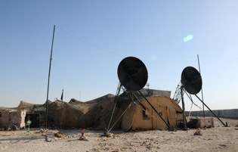
1
FOB Sensors
Support (Logistics) - Ground
DEF: Defensive ground units gain +1 DEF
REQ: Forward Operating Base
TRAITS: Detects Stealth on DEF only
0/1
Notes:
https://media.defense.gov/2010/Feb/13/2000394509/-1/-1/0/100130-F-3622Z-009.JPG
A 379th Expeditionary Communications Squadron TRC-170 Troposheric Scatter Microwave Radio Terminal site supports U.S. Army Patriot missile batteries from a non-disclosed Southwest Asia location Jan. 30, 2010. (U.S. Air Force photo by Senior Airman Kasey Zickmund)[RELEASED]

Slide 55
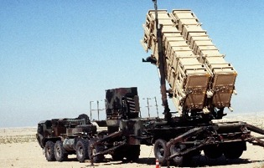
2
MIM-104 Patriot
Counter Air - Ground
DEF: (Air)
TRAITS: At the end of the turn, turn this facedown (unrevealed). Detects Stealth on DEF only
2/1
Notes:
https://commons.wikimedia.org/wiki/File:MIM-104_Patriot.JPG

Slide 56
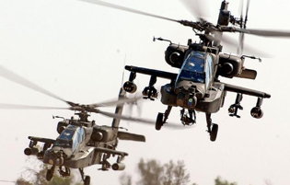
AH-64 Apache
1
Aviation Brigade – Air/Ground
ATK: (Ground)
DEF: (Ground)
TRAITS: BCT, Low altitudes enable this to be hit by forces capable of hitting ground targets
Assault helicopter battalions support ground force maneuver through air movement and air assault missions.
3/1
Notes:
https://www.army.mil/article/45344/army_lauds_achievements_of_rdecom_scientists
Two AH-64D Apaches from the 1st Battalion, 227th Aviation Regiment, 1st Air Cavalry Brigade, 1st Cavalry Division, come in for a landing at Camp Taji, Iraq, after completing a reconnaissance mission in the skies over Baghdad Nov. 6, 2009. AMRDEC scientists were awarded for their work to improve the Apache's communications systems. (Photo Credit: U.S. Army photo by Chief Warrant Officer 4 Daniel McClinton)

Slide 57
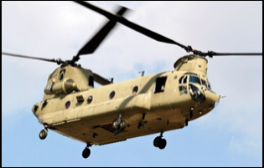
CH-47 Chinook
1
Aviation Brigade – Air/Ground
TRAITS: Reduces BCT cost by 1, low altitudes enable this to be hit by forces capable of hitting ground targets
-/1
Notes:
https://en.wikipedia.org/wiki/Boeing_CH-47_Chinook#/media/File:CH-47_Chinook_helicopter_flyby.jpg

Slide 58
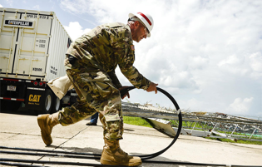
0
Army Corp of Engineers
Support (Logistics) - Ground
On the turn this card is played, discard up to 3 cards from draw pile to pay deploying cards in hand. Drawn cards can only be used for paying and do not go into hand.
TRAITS: Single-use, Charge
Sgt. Jesse Johnson with the 249th Engineering Battalion, a power generation battalion assigned to the U.S. Army Corps of Engineers, prepares to install a FEMA generator for the facility that has been without power since Hurricane Maria, Oct. 8, 2017. It will take time to get power restored to many areas, but work is underway between the U.S. Army Corps of Engineers, Department of Energy, local power authorities, and the private sector to get power restored in Puerto Rico. (U.S. Air Force photo by Master Sgt. Joshua L. DeMotts)
-/-
Notes:
https://www.army.mil/e2/c/images/2017/10/31/497296/original.jpg
Sgt. Jesse Johnson with the 249th Engineering Battalion, a power generation battalion assigned to the U.S. Army Corps of Engineers, prepares to install a FEMA generator for the facility that has been without power since Hurricane Maria, Oct. 8, 2017. It will take time to get power restored to many areas, but work is underway between the U.S. Army Corps of Engineers, Department of Energy, local power authorities, and the private sector to get power restored in Puerto Rico. (U.S. Air Force photo by Master Sgt. Joshua L. DeMotts)

Slide 59
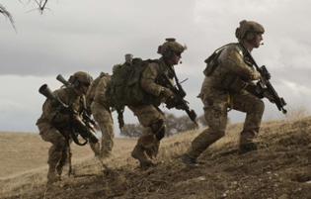
Special Operations
3
Special – Air/Ground
ATK: (Air, Ground, Cyber) Can target unrevealed targets; Can remove one cyber target
REQ: Air Superiority
TRAITS: Charge, Single-use
U.S. Army Rangers, assigned to 2nd Battalion, 75th Ranger Regiment, bound into position during Task Force Training on Fort Hunter Liggett, Calif., Jan. 30, 2014. Rangers constantly train to maintain their tactical proficiency. (U.S. Army photo by Spc. Steven Hitchcock/Released) (Photo Credit: Spc. Steven Hitchcock)
2/-
Notes:
U.S. Army Rangers, assigned to 2nd Battalion, 75th Ranger Regiment, bound into position during Task Force Training on Fort Hunter Liggett, Calif., Jan. 30, 2014. Rangers constantly train to maintain their tactical proficiency. (U.S. Army photo by Spc. Steven Hitchcock/Released) (Photo Credit: Spc. Steven Hitchcock)
https://www.army.mil/article/119709/75th_ranger_regiment_task_force_training

Slide 60
-
/

Slide 61
-
/
Notes:
Blank Card for student use

Slide 62
-
/

Slide 63
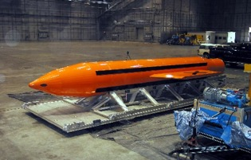
GBU-43/B MOAB
1
Equipment
TRAITS: Give C-130 units 3 attack (single use)
6/0
Notes:
https://en.wikipedia.org/wiki/GBU-43/B_MOAB#/media/File:MOAB_bomb.jpg

